Slide 1

Manufacturing Performance Analysis Dashboard
Presenter -Sumit Nerkar

Slide 2
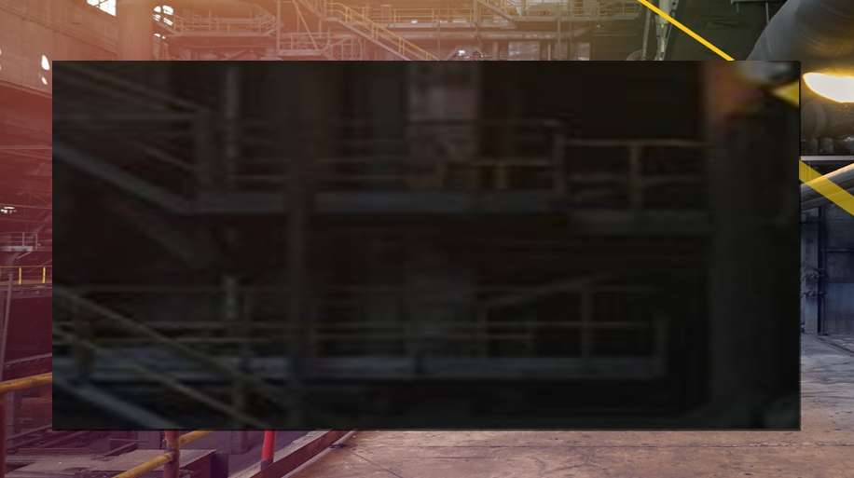
Introduction - Manufacturing Review Dashboard
The Manufacturing Review Dashboard provides a comprehensive overview of key metrics that track production performance and operational efficiency.
The dashboard enables stakeholders to monitor production output, rejections, wastage, and performance across employees, machines, and departments.
The main focus is on identifying areas for improvement to optimize manufacturing processes and reduce waste.

Slide 3

Problem Statement
The dashboard analysis is being conducted to review manufacturing capacity and assess operational efficiency by evaluating key performance indicators (KPIs).
The KPIs under review include:
Manufactured Quantity
Rejected Quantity
Processed Quantity
Wastage Quantity
Employee-wise Rejected Quantity
Machine-wise Rejected Quantity
Department-wise Manufactured and Rejected Quantity

Slide 4
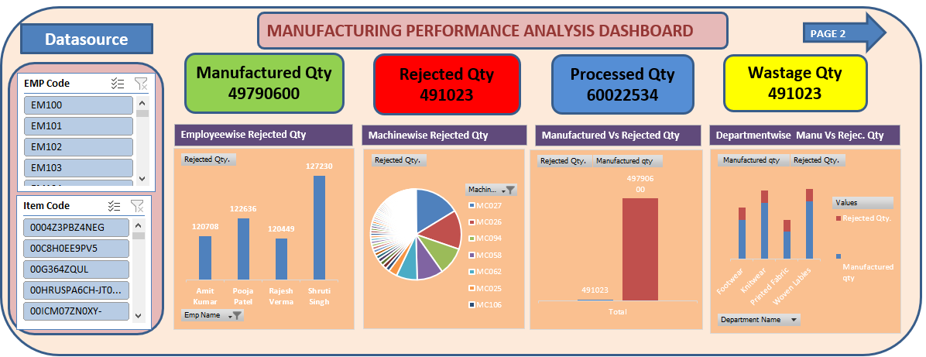
DASHBOARD

Slide 5
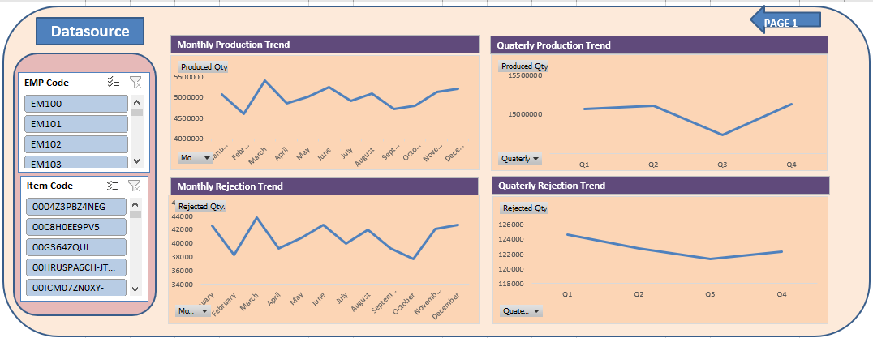
DASHBOARD

Slide 6
KPI Observations
Manufactured Quantity:
Total Manufactured Quantity: 49,790,600 units.
While production output is substantial, discrepancies exist between the Manufactured Quantity and the Processed Quantity of 60,022,534 units, suggesting potential data misalignment or inefficiencies in tracking production.
2. Rejected Quantity & Wastage Quantity:
Rejected Quantity: 491,023 units.
The Wastage Quantity directly matches the rejected units, indicating that all rejections lead to wastage. The rejection rate, though moderate, still contributes to significant operational inefficiencies.
3. Processed Quantity:
Processed Quantity: 60,022,534 units.
The processed quantity is higher than the manufactured quantity, which suggests potential rework or inconsistencies in the production data handling process across different stages.

Slide 7
KPI Observations
4.Employee-wise Rejected Quantity:
Shruti Singh has the highest rejected quantity at 127,230 units, followed by Rajesh Verma with 120,449 units.
This variation in employee performance highlights potential skill gaps or process-related issues that require closer examination.
5.Machine-wise Rejected Quantity:
Machines such as MC027 and MC026 show the highest rejection rates, contributing significantly to overall rejections.
These machines may require maintenance or upgrades to reduce their inefficiencies.
6.Department-wise Manufactured and Rejected Quantity:
The Footwear department has the highest rejection rate compared to other departments.
This suggests specific inefficiencies in the Footwear department that need process improvements or enhanced quality control measures to reduce waste.

Slide 8
Conclusion
The dashboard highlights key inefficiencies in the manufacturing process, especially in areas related to rejected and wasted quantities. While overall production capacity is strong, inefficiencies across employees, machines, and departments are driving up rejection rates and reducing operational effectiveness.

Slide 9
Recommendations
Employee Training and Process Standardization:
Focus on targeted training for employees with higher rejection rates and review work processes to ensure consistency across all operators.
Machine Maintenance and Upgrades:
Prioritize preventive maintenance or upgrades for machines with higher rejection rates to improve efficiency and reduce defects.
Departmental Process Improvements:
Investigate the specific processes in departments like Footwear that have higher rejection rates and implement quality control measures to reduce wastage.
Data Alignment:
Ensure better consistency between manufactured and processed data to improve tracking accuracy and operational insights.

Slide 10


